Slide 1
Dank Spots
An Idea by William Doudna

Slide 2
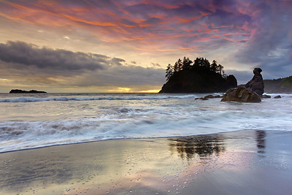
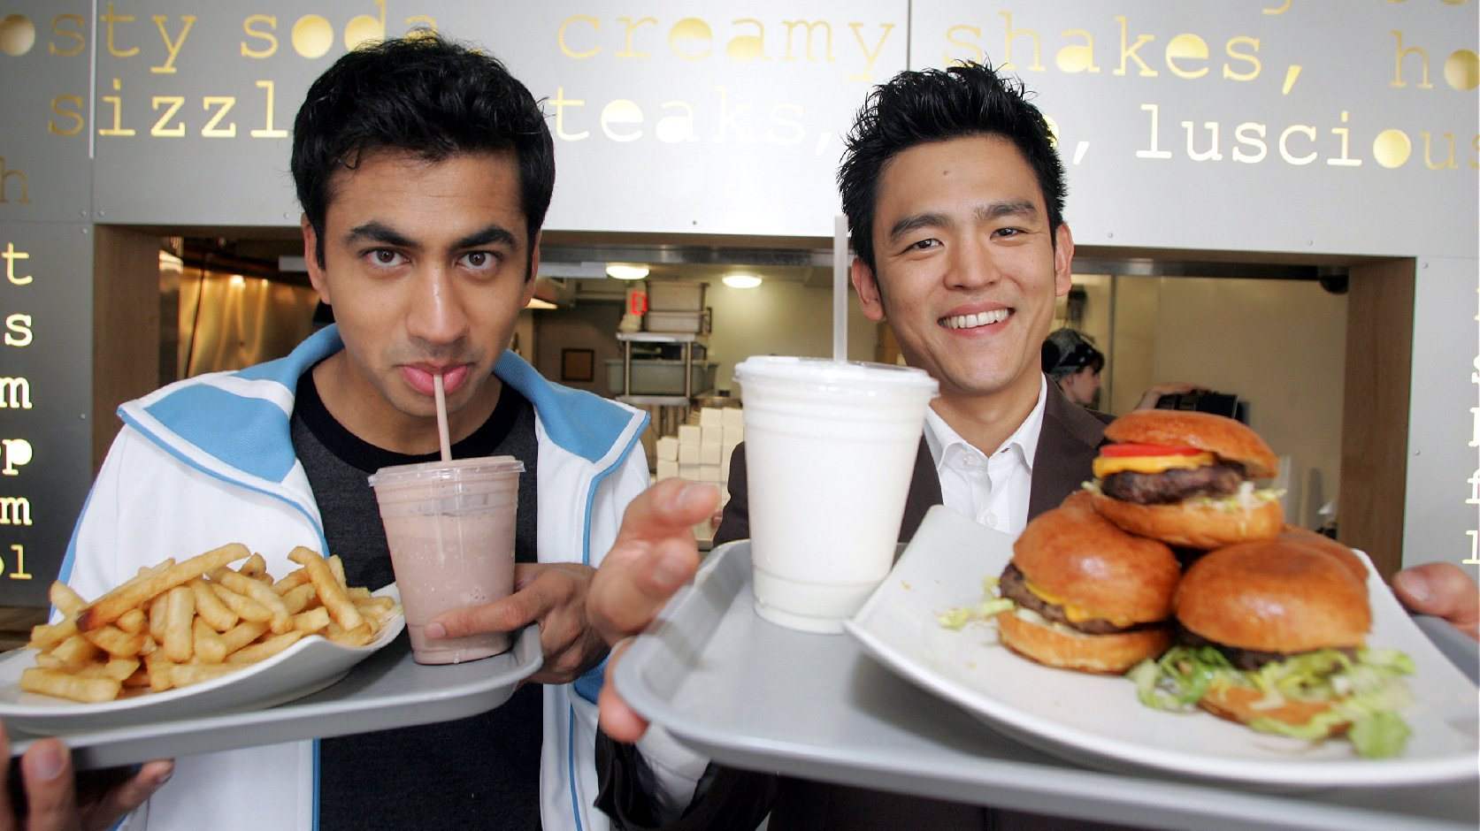
Think of a relaxing evening, what does this include?
A nice sunset?
Good food?
Friends and family?
Possibly a joint?

Slide 3
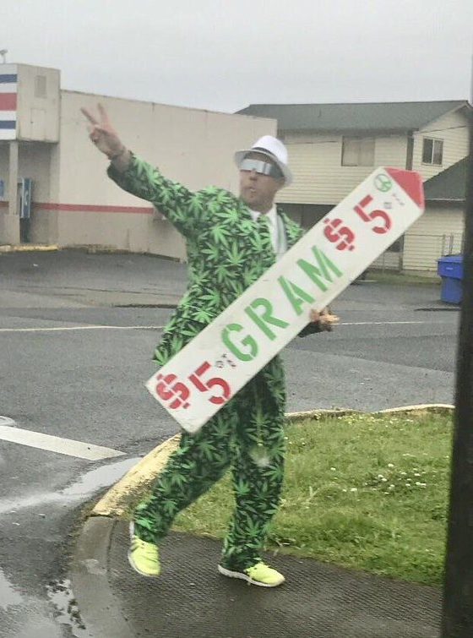
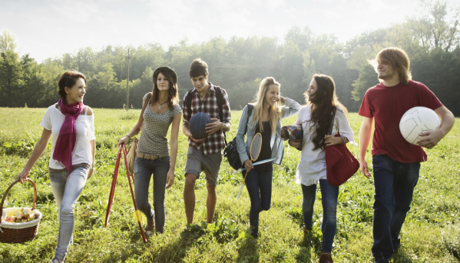
The Resource Manual For Stoners
Where to smoke along with attribute descriptors helping show what kind of spot it is.
Where to get munchies post smoke sesh or just after watching sunset.
Dispensary ratings and deal postings.

Slide 4
Cool Features
Stoned and cant decide where to eat? Let dank spots decide by finding the closets cheap munchies spot.
Is it still muddy after the rain from yesterday? Filter spots to find places that stay dry or don’t have a mud problem.
You and your friends can’t decide where to meet up at? Let Dank spots decide by calculating the closest spot between all of you and your friends.

Slide 5

Form a local Stoner’s community
Contribute your special smoke spot to the community and find other spots that are contributed from fellow community members

Slide 6
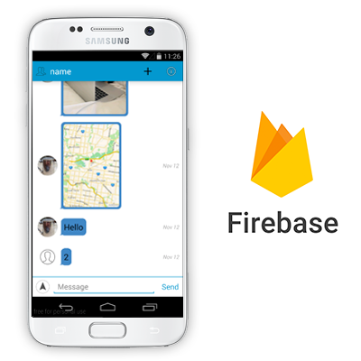
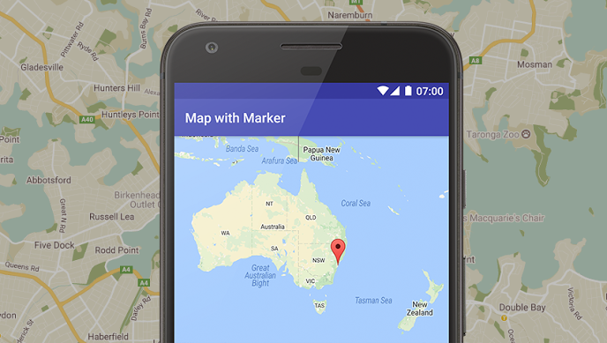
This app will implement
The google maps API
Firebase to host chatrooms and discussion threads
Use android class ‘Room’ to communicate with a database (which we would also have to figure out how to set up).

Slide 7
Why make this app? Would anyone use it?
Weed is now legal in California!
This could potentially be a good ad platform for the strong marijuana industry here.
Could also cater to outdoor enthusiasts and hikers.

